Slide 1
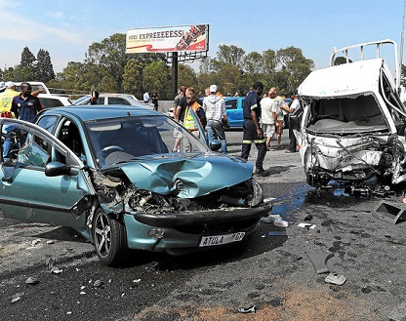
Data Visualization and Analysis of US Accidents
Olufemi Babalola
Practicum II

Slide 2
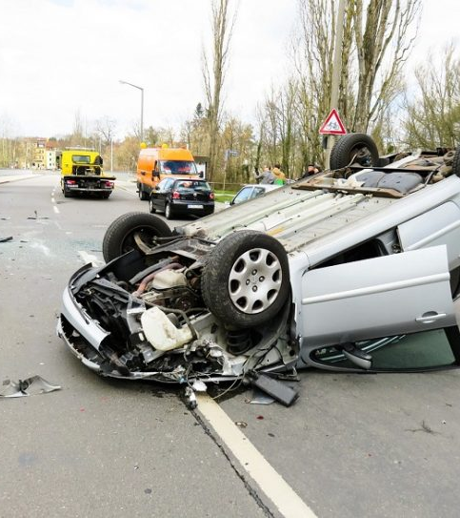

Overview
The US Accidents data is a countrywide traffic accident dataset, which covers 49 states of the United States. The data is continuously being collected from February 2016 to March 2019 and consists of 2.974 million rows with 49 variables.

Slide 3

Objective
This study attempts to visualize and analyze features of US Accidents records with the aim of revealing valuable insight.
The insights reveal:
States and Cities reporting highest record of accidents
The severity of these occurrences.
The duration of each accidents
The Impact of weather conditions and other traffic objects

Slide 4
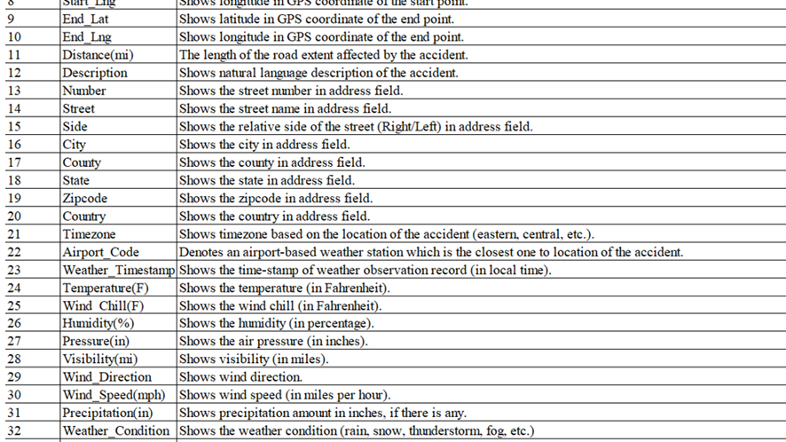
Description of the dataset

Slide 5
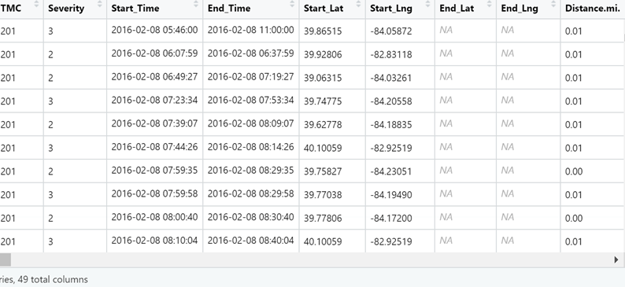
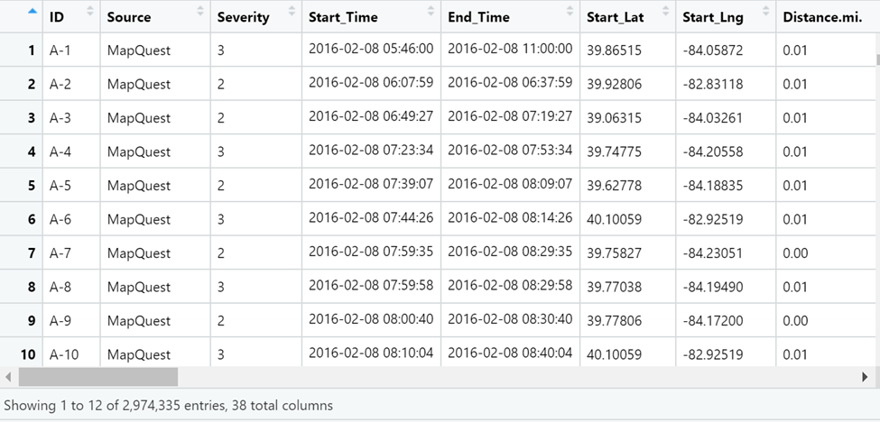
Removing Missing Values

Slide 6
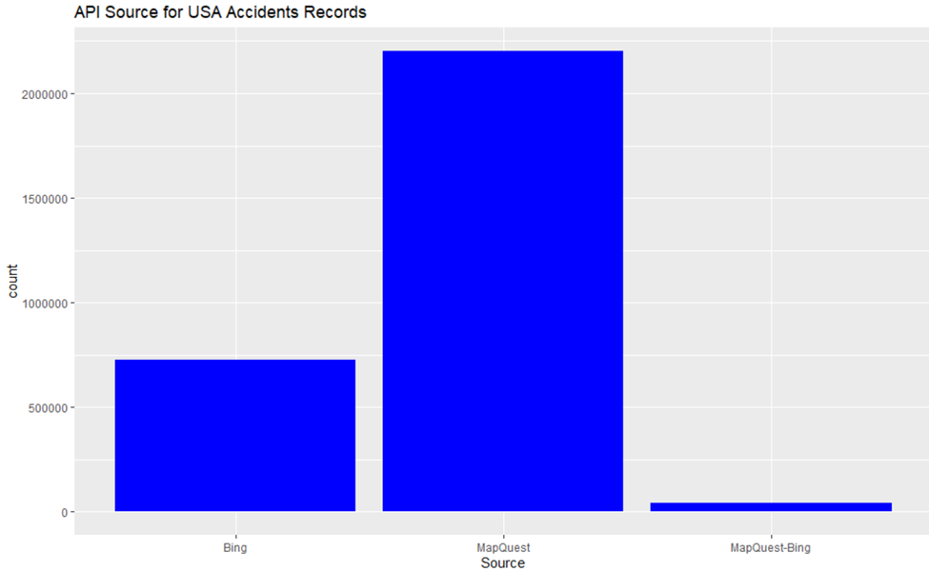
API Source of Accidents dataset
There are only three API sources that reported the accidents. It can be observed that most of the accidents (over 2,000,000) were reported by MapQuest, followed by Bing.

Slide 7
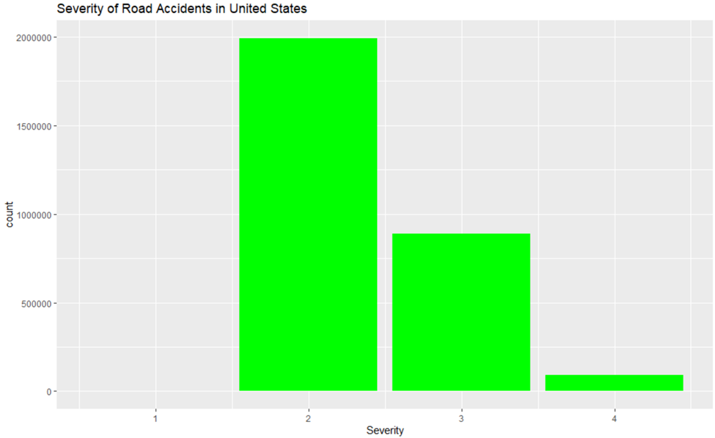
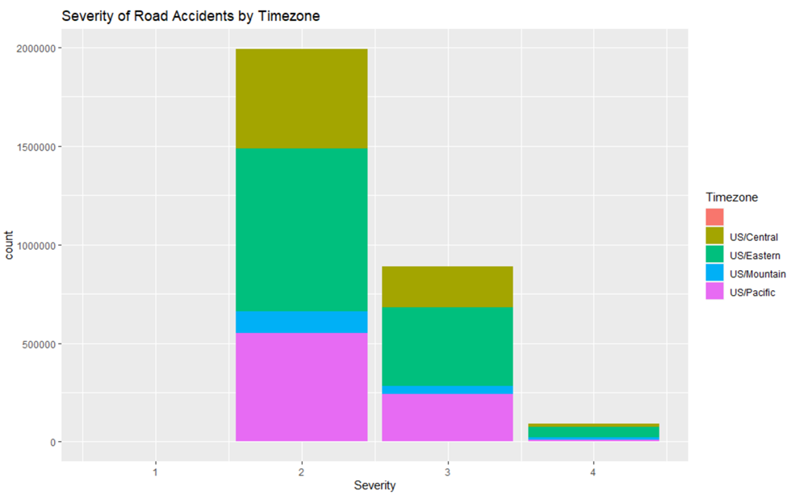
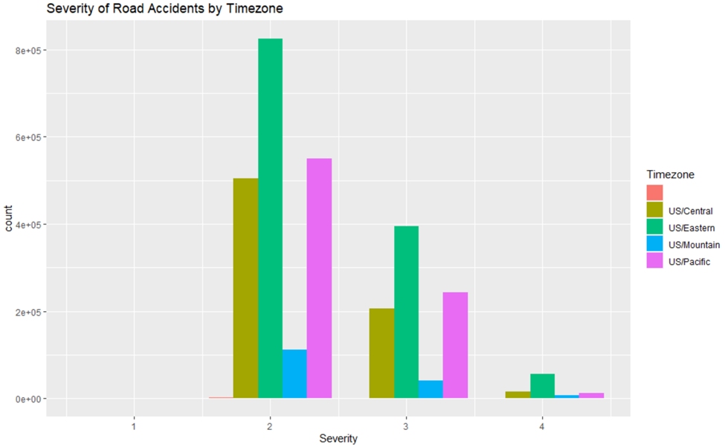
Severity of the Road Accidents

Slide 8
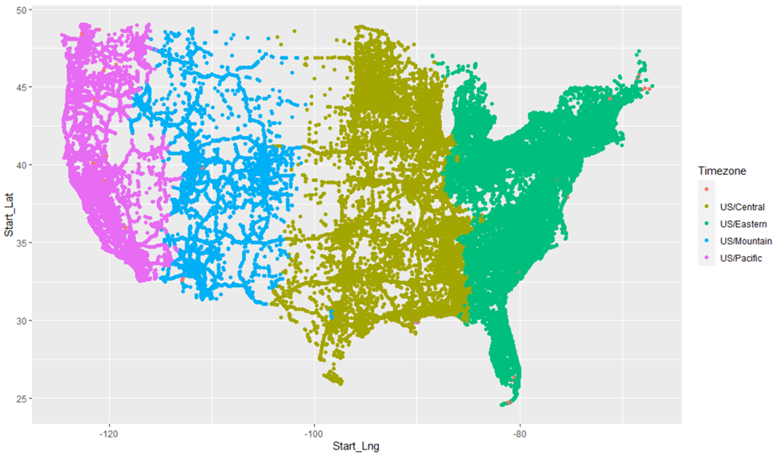
Accidents spread by Time Zones
The Start_Lat and Start_Lng were used to get the exact location of the accidents.

Slide 9
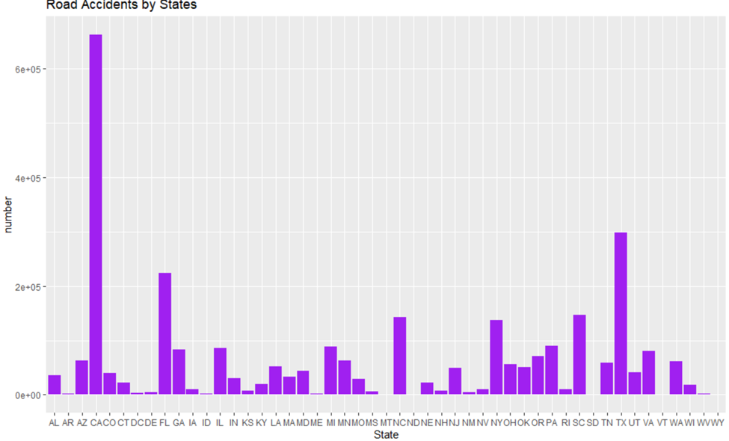
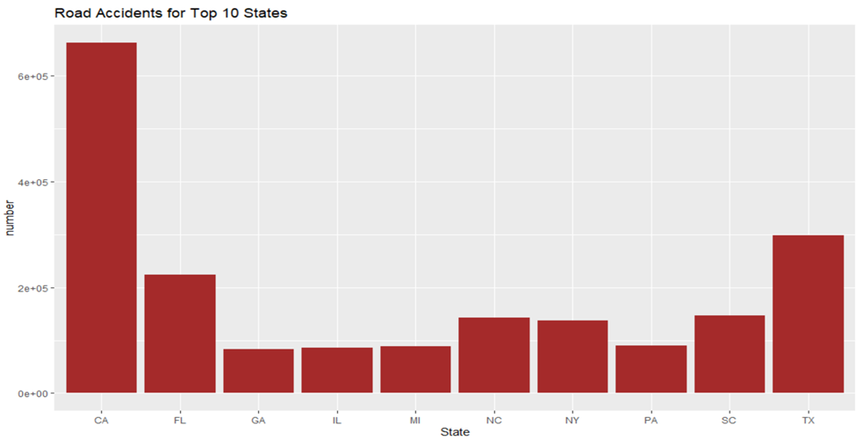
Ranking by States
The plot illustrates that California (CA) has the greatest number of accidents followed by Texas (TX) and Florida (FL). The number of accidents in California is almost twice the number of accidents in Texas.

Slide 10
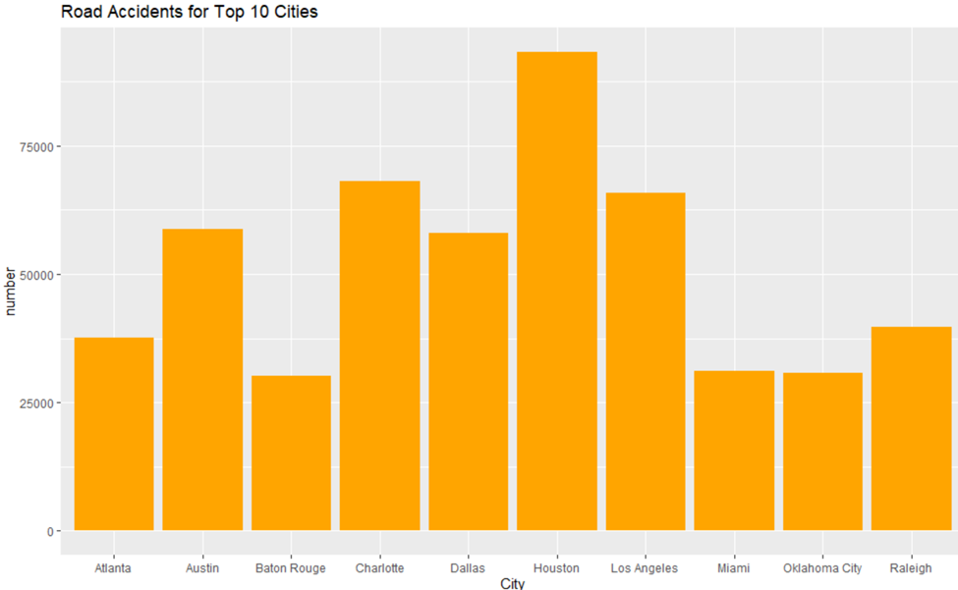
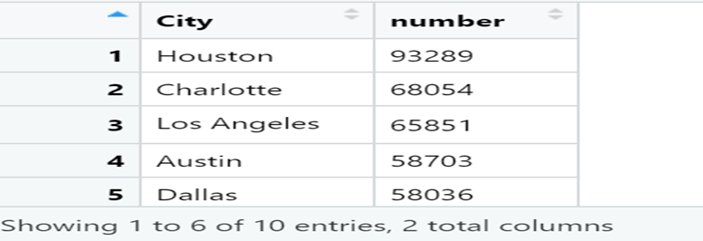
Ranking by Cities
This plot, shows that most of the accidents occurred in Houston, followed by Charlotte and Los Angeles.

Slide 11
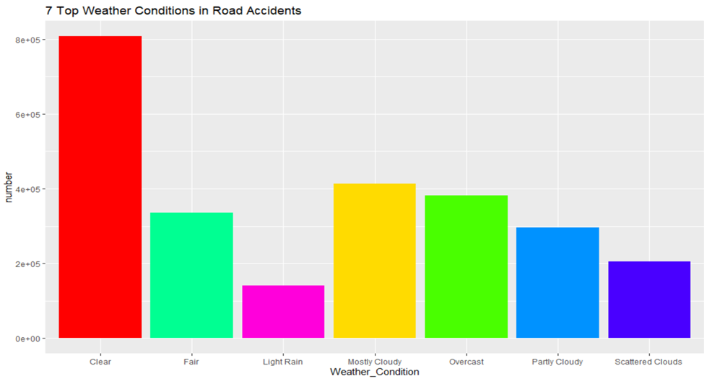
Weather Conditions effects on Road Accidents
The plot shows that the weather condition for most of the accidents were clear, followed by mostly cloudy and overcast. Overcast and mostly cloudy are reasonable factors for accidents unlike clear, which means that weather conditions does not play an important role.

Slide 12
Conclusion
The US Accidents dataset downloaded from Kaggle was visualized and analyzed after thorough cleaning of missing values and eliminating other less important features of the dataset. From this study, it is interesting to see many exciting results – one of which is that California had the highest number of accidents among the states in North America. While Houston, a city in Texas, recorded the highest number of accidents among the cities in North America. I also discovered that most of the accidents occurred under clear weather conditions. Also, majority of the accidents took place in the Eastern Time Zone. The most important feature of this data is the severity of the accidents reported. It is unfortunate to know that no record of accidents between 0 and 1 severity were recorded and most of the severity where in severity 2. Another factor that was deduced from the data was the duration of accidents.

